Slide 1
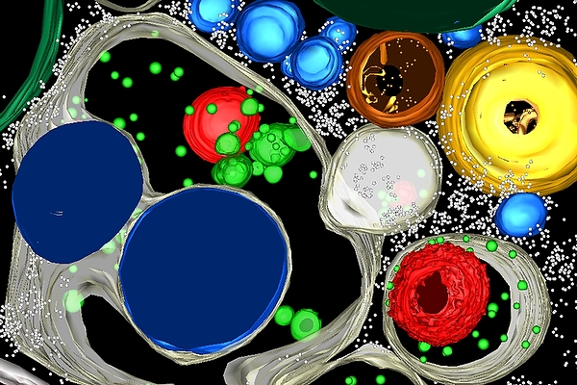
HORMONES 101

Slide 2
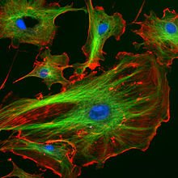
Thank you to Amy and QSXX
Amy is a marketing guru, leading strategist, philanthropist, and musician.
.. AND all around AWESOME!
You can follow her @amyjmerrill

Slide 3
WeWork: a shared co-working space

Slide 4
The Hormone Project (www.hormoneproject.org)
Women and men around the world continue to treat depression, skin and stomach problems, and more serious issues like infertility and cancer: but the system is broken, and effects of hormones within the body's system remain largely unmapped. We believe it is as critical to map and understand our hormones as it is to map human DNA and the brain.
The Hormone Project was created to unite the world’s best doctors, researchers and scientists, support them in advancing hormone research and innovation in biotechnology and personalized health, and to give individuals a platform to be heard and to take action.

Slide 5
Me!
- PhD in Immunology
(Pregnancy)
Partners Healthcare RVL
(MGH & BWH in Boston)
VC in Melbourne, Australia
SH @ CM in NYC
You can follow me @Brandy_Houser

Slide 6
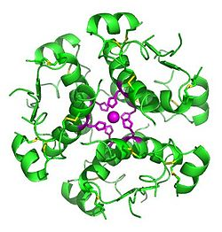
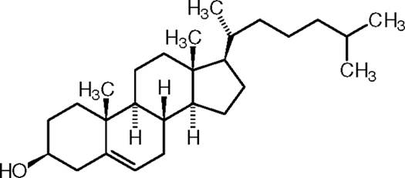
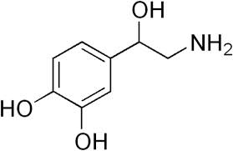
What are hormones?
Hormones are our body’s messengers. They aid in communication between various organs allowing for normal body function and processing to occur.
There are 3 types of hormones: protein, steroids, and tyrosine based
(1) Protein (most of our body’s hormones) : secondary messengers
E.g. insulin
(2) Steroids (lipids) : primary messengers
E.g. Derived from cholesterol
(3) Tyrosine derivatives: thyroid gland
E.g. Catecholamines (adrenal medulla): “fight or flight” - epinephrine
Notes:
The natural steroid hormones are generally synthesized from cholesterol in the gonads and adrenal glands. These forms of hormones are lipids. They can pass through the cell membrane[5] as they are fat-soluble, and then bind to steroid hormone receptors which may be nuclear or cytosolic depending on the steroid hormone, to bring about changes within the cell. Steroid hormones are generally carried in the blood bound to specific carrier proteins such as sex hormone-binding globulin or corticosteroid-binding globulin. Further conversions and catabolism occurs in the liver, in other "peripheral" tissues, and in the target tissues.

Slide 7
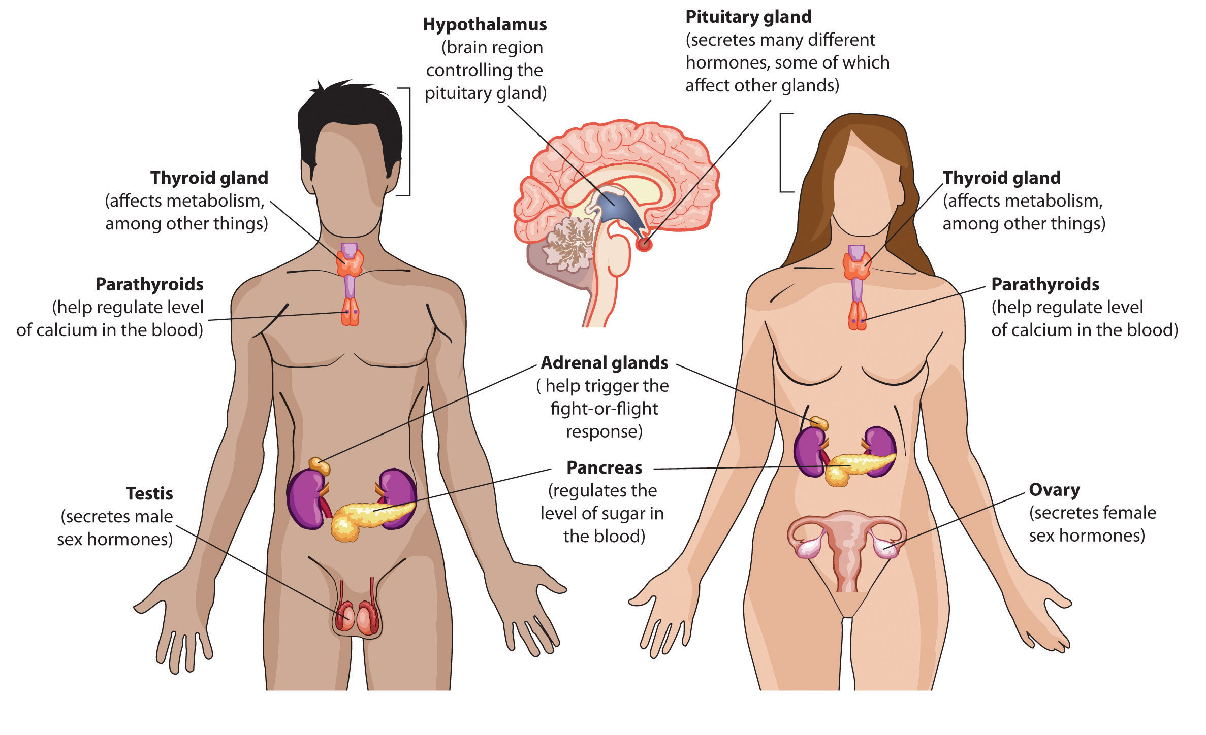
Where do hormones come from?
The short answer: The endocrine system.
What is that? : A series of glands that secrete chemical messages called hormones.
Flatworldknowledge.com
Notes:
All of our responses that we experience are signalled by hormones. From fear, to urination, to delivering babies.

Slide 8
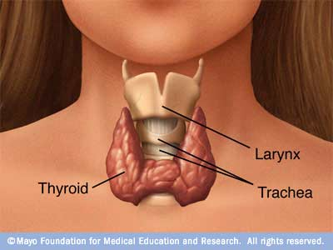
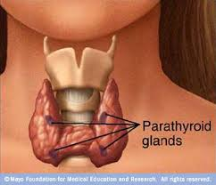
The Control Center:
Is found in the forebrain and is composed of the hypothalamus and the pituitary gland
The hypothalamus is where ADH (anti-diuretic hormone) and oxytocin are made
The hypothalamus receives signals from the pituitary gland (aka the nervous system)
The pituitary gland is the size of a pea and is considered the “master gland.” It also produces LH and FSH during the menstrual cycle.
The pituitary gland directs the thyroid gland that regulates your body’s metabolism.
The thyroid gland communicates with the parathyroid gland where blood-calcium levels are regulated. Calcium is needed for bone growth and muscle contraction.
Notes:
ADH prevents the production of overly dilute urine. Inappropriate ADH secretion results in electrolyte balance causing nausea, vomiting, muscle cramps, etc.
Breaking the seal : Their fluid absorption, in turn, is regulated by a hormone known as vasopressinor antidiuretic hormone (ADH). Vasopressin is released when osmoreceptors—cells that sense water pressure—detect that there’s too little water in our bodies. Then ADH comes along to the kidneys and says, “Oy! Conserve some more water!” As we conserve water, less urine is produced.
Ethanol throws a wrench in the works by inhibiting the release of ADH. Thus the mere presence of alcohol in your body makes you produce more pee, for any given fluid intake. Of course, it doesn’t help that when drinking, especially when drinking lower-alcohol content beverages like beer, we tend to drink a lot more in a shorter timespan than we otherwise do. The reason the effect is delayed—the reason there is an illusion of a seal to break—is that it takes some time for the body to “use up” the vasopressin that’s already present in your body, and it takes a while for the full effect of alcohol’s diuretic properties to be felt. And of course, it takes some time for that beer to travel from the bottle, down your throat, through your stomach and kidneys and into your bladder as urine. Once your kidneys are working full tilt, it takes a while for them to ramp down production again.
Oytocin: important for delivery and lacation; pair bonding activities, and those that have defects in the receptor are linked to aggression.

Slide 9
The Adrenal Glands
Flatworldknowledge.com
Notes:
All of our responses that we experience are signalled by hormones. From fear, to urination, to delivering babies.

Slide 10
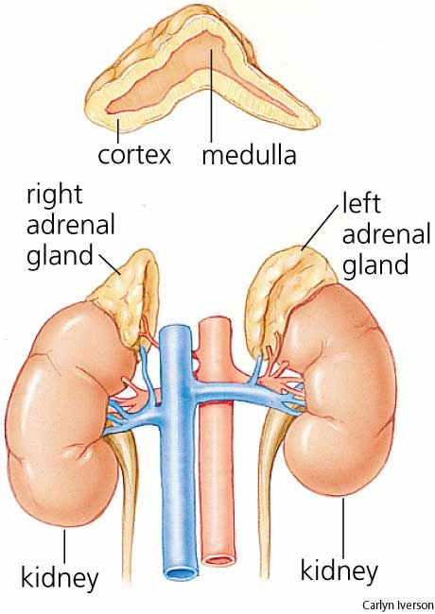
The CC communicates with the adrenal glands
Their name is derived from their location: adjacent to renal.
Outer (Cortex) | Inner (Medulla)
Produces steroids | Produces catacholamines
e.g. adrenal corticosteroids | Epinephrine (adrenaline) and norepinephrine
Which is processed into cortisol aldesterone | “fight or flight” response
Fluid retention & Increased susceptibility to infection

Slide 11
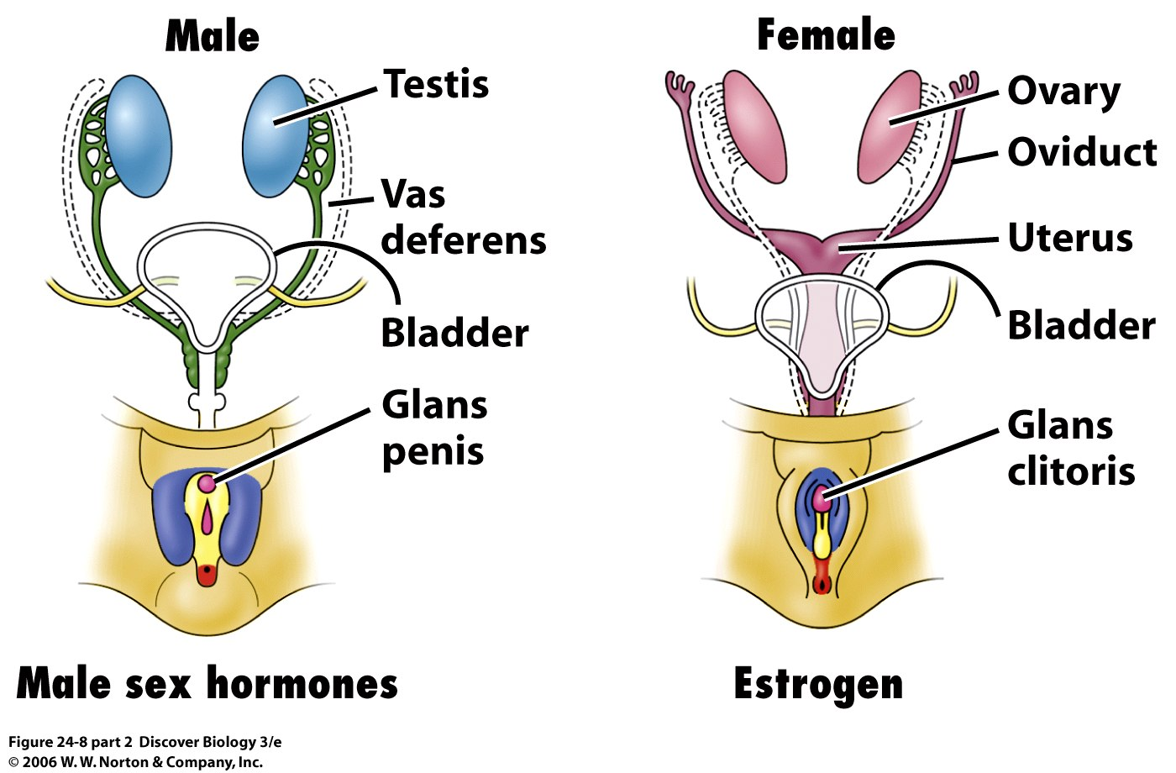
And not to be forgotten: the gonads
What are the gonads? An organ that produces gametes (egg or sperm) – the ovary and testes.
This is where sex hormones play an important role in secondary sex characteristics, puberty, conception, labor, menopause, etc.

Slide 12
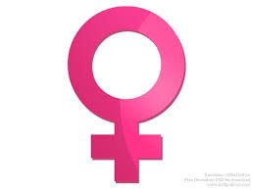
But let’s look a bit closer at

Slide 13
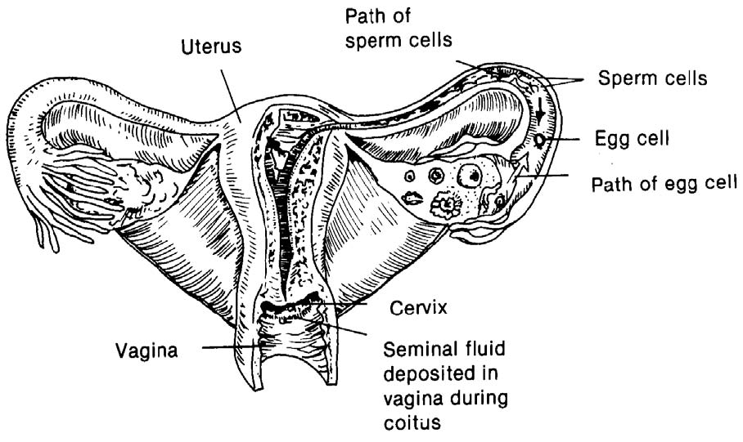
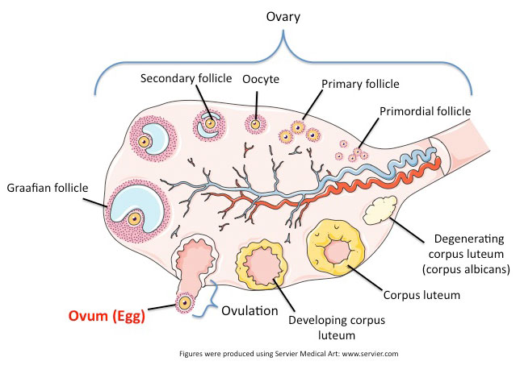
Female gonads: The ovary

Slide 14
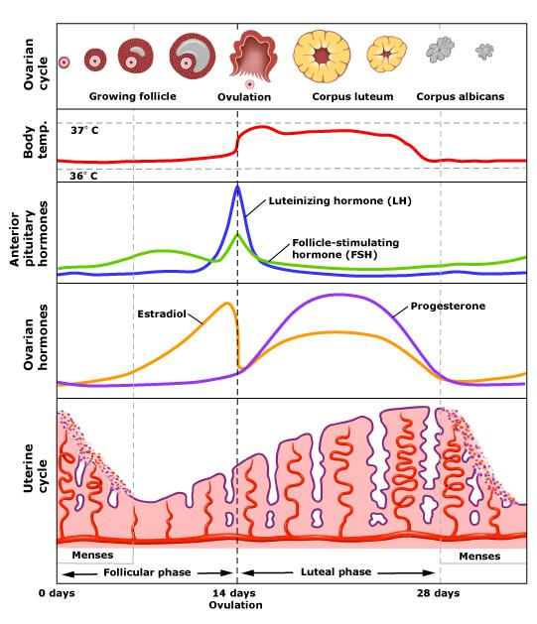
Let’s talk basics on menstruation
Notes:
LH – an acute rise in LH triggers ovulation and development of the corpus luteum. There are kits out there that measure LH for fertility purposes
.
FSH is necessary for stimulation and growth of immature of ovarian follicles. Estradiol represses FSH – that is why when ovulation occurs estradiol drops allowing FSH to spike.

Slide 15
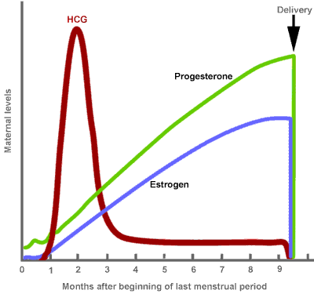
Hormones and pregnancy

Slide 16
What is pre-menstrual syndrome (PMS)?
NY Presbyterian: “As many as 85 percent of women, during their reproductive years, experience some of the common symptoms associated with PMS. Further, approximately 30 to 40 percent of these women experience symptoms so severe that they disrupt daily activities. It is estimated that less than 10 percent of women have symptoms so extreme that they are considered disabled by the condition.”
Cause of PMS:
Possibly: estrogen-progesterone imbalance (not out of normal levels)
hyperprolactinemia (excessive secretion of prolactin, the hormone that stimulates breast development)
excessive aldosterone, or ADH (hormone that functions in the regulation of the metabolism of sodium, chloride, and potassium)
carbohydrate metabolism changes
retention of sodium and water by the kidneys
hypoglycemia (low blood sugar)
Notes:
PMS:
Linked to genetic component yet unidentified based on twin studies
Some thought is that central nervous system neurotransmitter interactions with sex hormones are affected.
Serotonin ( a neurotransmitter) is linked as well as glutamate (which spikes) – glutamate has been tied to mood disorders in several studies.
Preliminary studies suggest that up to 40% of women with PMS symptoms have a significant decline in their circulating serum levels of beta-endorphin (a naturally occurring opioid neurotransmitter which has an affinity for the same receptors that is accessed by heroin and other opiates (PMS symptoms and opiate withdrawal have overlapping symptom profiles)
Some women have been found to have heightened levels of pseuocholinesterase – which has been linked to anxiety-train disorders.
Evolutionary questions…

Slide 17
Natural ways to mitigate PMS
Life style changes that can help:
regular exercise (3 to 5 times each week)
a well-balanced diet:
It is generally recommended that women with PMS increase their intake of whole grains, vegetables, and fruit, while decreasing their intake of salt, sugar, caffeine, and alcohol.
adequate sleep and rest
WATER
(Bridget will discuss herbalism options at the end.)

Slide 18
What causes hormone imbalances?
Signs of hormone imbalance:
Persistent weight gain
Belly fat and loss of muscle mass
Low libido
Fatigue
Anxiety, irritability, depression
Insomnia
Digestion problems
Food cravings
Prolonged stress disrupts your adrenals
disrupting the production of adrenaline and
cortisol. It results in chronically elevated cortisol
levels which results in weight gain (around mid-
section), blood sugar imbalances, thinning skin,
muscle wasting, memory loss, high blood pressure, etc.
- The thyroid, which regulates metabolism, may turn down its hormonal activity in an attempt to reverse adrenal overdrive. Some symptoms of hypothyroidism include fatigue, weight gain, fibroids, endometriosis, ovarian cysts, heavy bleeding, fibrocystic breast disease, depression, PMS, migraines, lack of concentration, cold hands and feet, menopausal symptoms, miscarriage and infertility.
(2) Reduced exercise/sedentary lifestyle
(3) A high salt diet
(4) A candida waste product produces a false estrogen, which tricks the body into thinking it has produced adequate levels, signaling a reduction of its own estrogen. Elevated estrogen levels also increase vaginal candidiasis incidence. Estrogen will literally feed candida growth, which is why birth control pills and estrogen replacement therapy put women at a greater risk of developing candida.

Slide 19
Just remember….
The world moves at whatever pace you allow it.

Slide 20
Natural ways to mitigate hormone imbalance
Avoid “white foods” – including alcohol.
Supplement with omega-3s
Steer clear of commercial oils (vegetable oil, peanut oil, canola oil, soybean oil, margarine, shortening
Limit caffeine
Eat coconut oil and avocados
Reduce stress
Vitamin D supplements
Increase fiber
Increase fruits and vegetables
Exercise
Recognize the hormone disrupters in your bathroom cabinet:
- parabens,
- phthalates
- bisphenol-A (BPA)
12. Manage your stress
13. Consider weaning off synthetic hormones (birth control)

Slide 21
Herbalism and wellness programs for hormone balance management:
About Bridget Bridget Molloy is an Herbalist, Educator, & Event Planner at the Nourished Health Center in uptown based out of Denver, Colorado. She is also has an endless smile and interest in health. The role of health through botanical medicine and healthy foods is vital for shaping personal, community, and global health and well-being. Her interest in botanical medicine began as a child with drinking tea and playing in our backyard gardens. Bridget loves helping others of all ages to enhance their personal health and well-being for a happier, sustainable, and productive lifestyle, which brought her to start Bridget’s Botanicals in March of 2014. Bridget’s specialties are in stress, anxiety, chronic fatigue, and sex health.
Bridget Molloy
bridgetsbotanicals.org

